Slide 1
ARENA: biorefinery Lars DM Ottosen, department of engineering, AU

Slide 2
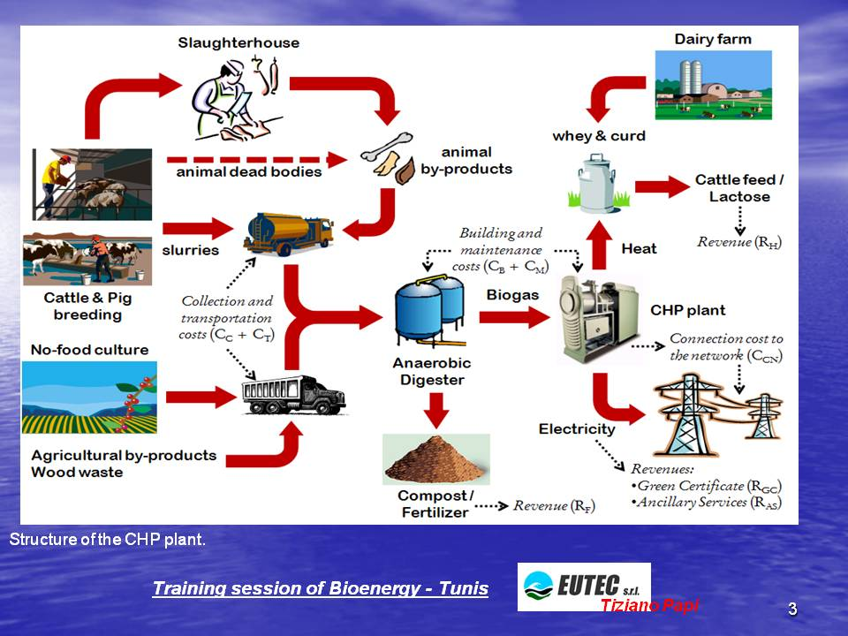
Biorefinering can be defined as the sustainable processing of biomass into a spectrum of bio-based products (food, feed, chemicals, materials) and bioenergy (biofuels, power and/or heat).

Slide 3
The challenges:
Most energy and materials we use origin from non-renewable resources (fossils)
Biomass can replace fossils, but fertile agricultural land is a limited ressource
How do we get the most out of our scarce biomass?
How do get more biomass without compromising sustainability (soil quality, energy consumption, nature, environment)

Slide 4
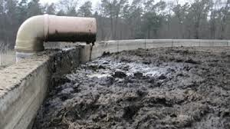
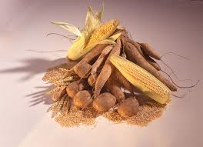
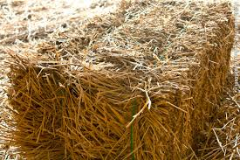
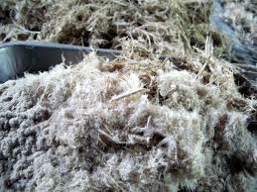
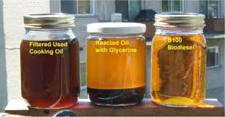
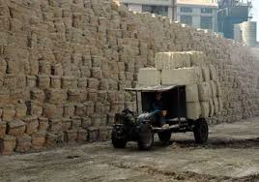
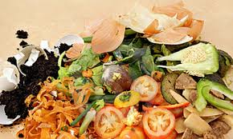
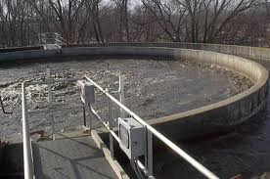
Biomass?
Manure
starch
Protein
Cellulose, lignocllulose, lignin
Fats and oils
Sludge
Cellulose, lignocllulose, lignin
Mix

Slide 5
Fine
chemicals
Food
Increase in value
Decrease in market size
Feed
Materials (bulk chem.)
Energy (transportation fuel)
Energy (heat)

Slide 6
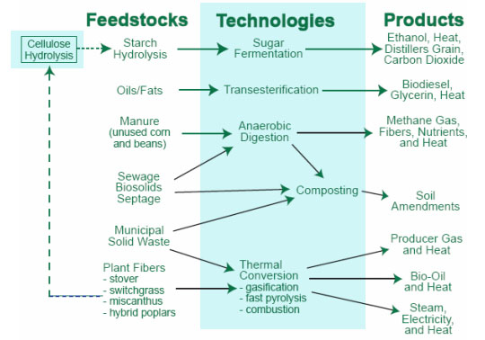
Plastic, monomers, polymers,
platform chemicals ?
Fatty acid derivates, plastizisers?
Biogas to natural gas quality?
Fertilizers ?
Plastic, monomers, polymers ?
More efficient and value adding (yet sustainable) utilization of biomass is needed !

Slide 7
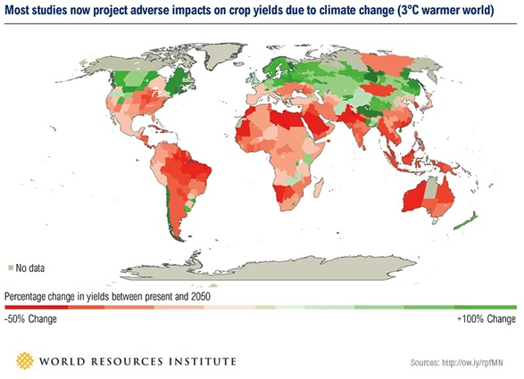
More biomass, but how?

Slide 8
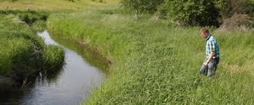
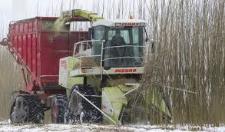
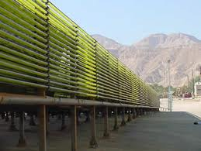
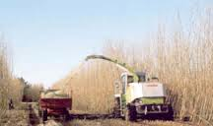
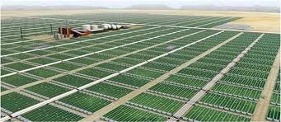
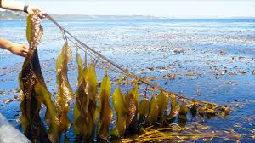
More biomass ?

Slide 9
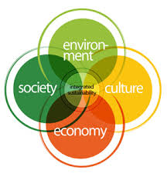
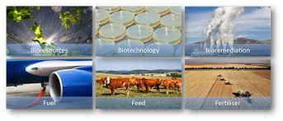
More biomass!
Higher yield pr hectare?
New hectares?
New cultivation systems?
Cost efficiency, energy balance, sustainability

Slide 10
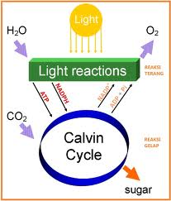
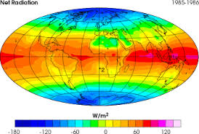
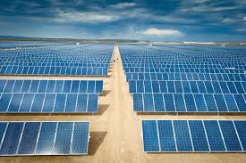
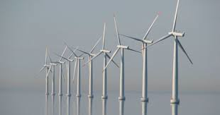
Think radical!

Slide 11
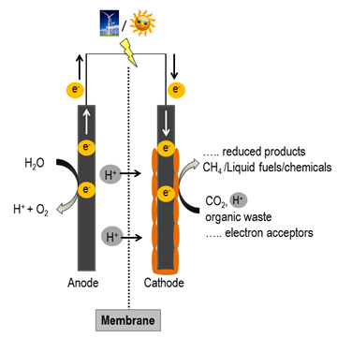
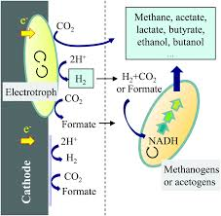
Can we use the sun (or fusion energy or…) to produce food feed
and materials without water and agricultural soil?
Amino acids, proteins, oils…….

Slide 12

APPLIED MICROBIOLOGY (Q4)
http://kursuskatalog.au.dk/en/coursecatalog/Course/show/55030

